Slide 1

SYNOPSIS Presentation
on
ONLINE INTERNSHIP FINDER
by
Akansha Tyagi 202410116100014
Akshita gupta 202410116100017
Akansha Tomar 202410116100013
Aanchal 202410116100002
Session:2025-2026 (III Semester)
Under the supervision of
Prof. (Dr.) / Dr. / Mr. Shashank Bhar
Department Of Computer Applications
KIET GROUP OF INSTITUTIONS, DELHI-NCR, GHAZIABAD-201206

Slide 2

ONLINE INTERNSHIP FINDER
This project introduces an innovative job and internship portal designed to streamline the discovery and application process for students and early-career job seekers. We integrate diverse listings, enhance transparency, and simplify referrals to empower your career journey.

Slide 3
Project Overview
Solving Your Job Search Challenges
The Problem:
Our Solution & Impact:
Too many job portals, too much time wasted.
Reduces effort in finding relevant opportunities.
Lack of company transparency.
Informed applications via reviews & LinkedIn.
No easy referral process.
Boosts referral chances for applicants.
Our platform aims to cut through the noise, providing a single, trusted source for your job and internship needs, ensuring every application is strategic and supported by clear company insights.

Slide 4
Project Objectives
1
Real-time Job Listings
2
Advanced Search
Provide real-time internship and job listings using REST API.
Allow domain-based search (location, stipend, etc.).
3
Secure Authentication
4
Company Insights & Networking
Integrate secure authentication before applying.
Enable users to check company reviews and LinkedIn profiles for networking/referrals.

Slide 5
Project Scope
Included Features:
Internship & job listing from APIs
Filtering by domain, stipend, location
Login/Signup with authentication
Apply button with application redirection
Company reviews & LinkedIn links
Auto-deletion of expired listings (10-day window)
Fetching Keywords from Resume through AI
This focused scope ensures we deliver core functionality with high quality, addressing the most pressing needs of job seekers first.

Slide 6





Methodology
Our Tech Stack: Robust & Modern
Frontend
Backend
Database
React.js
Node.js
MongoDB
Authentication
Version Control
JWT
GitHub
This technology stack ensures a scalable, secure, and user-friendly platform, leveraging industry-standard tools for optimal performance and maintainability.

Slide 7
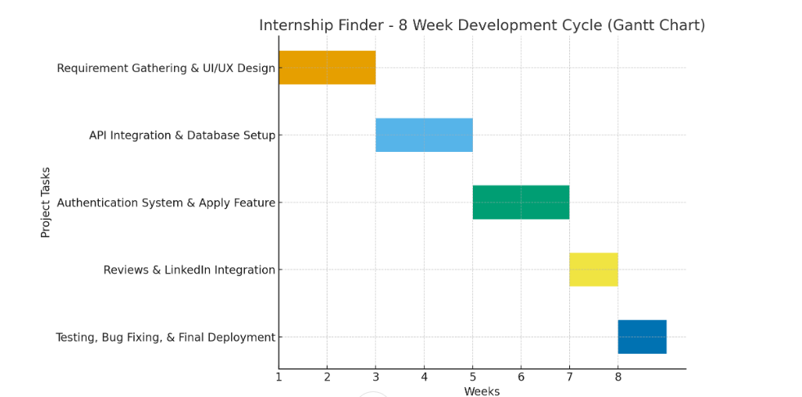
Project Timeline
Key Milestones: 8-Week Development Cycle
Weeks 1–2
Requirement Gathering & UI/UX Design
Weeks 3–4
API Integration & Database Setup
Weeks 5–6
Authentication System & Apply Feature
Week 7
Reviews & LinkedIn Integration
Week 8
Testing, Bug Fixing, & Final Deployment
This structured timeline ensures efficient development and timely delivery of a fully functional and robust job portal.

Slide 8
Project Outcome & Future
Your Gateway to Career Success
Expected Results
Future Scope
Simplified job search for students and job seekers.
Mobile Application: Bringing the portal to your fingertips.
Increased transparency through company insights.
Employer Dashboard: Empowering companies to post directly.
Improved networking and referral opportunities.
This web application will be a powerful tool for navigating the competitive job market.
Our vision extends beyond the initial launch, with plans for continuous enhancement and innovation.

